Slide 1
Enhancing PGRKAM Platform with Integrated Analytics for User Engagement Insights
CSE7101- Capstone Project
Review-1
Batch Number:
Under the Supervision of,
Dr./Mr./Ms./Prof.
Professor / Associate Professor / Assistant Professor
School of Computer Science and Engineering
Presidency University
Roll Number | Student Name
20221COM0023 | AAMNARIFA
20221COM0027 | BHOOMIKA
20221COM0028 | HEMAVATI PV
Name of the Program: COM
Name of the HoD: DR.PALLAVI
Name of the Program Project Coordinator: MS.YOGEETHA B.R
Name of the School Project Coordinators: Dr. Sampath A K , Dr. Geetha A

Slide 2
Problem Statement Number:
Problem Statement Number: [16]
Organization: Punjab Government – PGRKAM(Punjab Ghar Ghar Rozgar and Karobar Mission)
Category: Software
Problem Description: While the platform provides comprehensive employment data, it does not include integrated analytics tools to monitor user interactions and engagement patterns. Without these insights, it is challenging to evaluate usability, identify pain points, or tailor offerings to improve user experience and service relevance..

Slide 3
Problem Statement
The PGRKAM web application (www.pgrkam.com) and Android application provide employment data to prospective candidates in Punjab.
Despite having a large user base, the platform lacks integrated analytics tools to understand how users consume information, leading to missed opportunities for improving user engagement, personalization, and policy-making.

Slide 4
Objectives
Integrate advanced analytics tools into the PGRKAM platform for monitoring user interactions.
Provide visual dashboards for stakeholders to analyze usage trends.
Enable data-driven decision-making for improving platform efficiency and user experience.
Ensure secure and scalable analytics integration without compromising user privacy.

Slide 5
Background and Related work for title Selection
PGRKAM provides employment opportunities in Punjab (Web + Android app).
Large user base but no analytics tools to study user behavior.
Limits personalization, engagement, and policy-making.
Other platforms (LinkedIn, Naukri, NCS, Coursera) already use analytics successfully.
Shows a clear gap in PGRKAM’s system

Slide 6
Analysis of Problem Statement
Technology Stack Components:
Frontend: Simple web technologies (HTML, CSS, JavaScript)
Backend: Java(Spring boot)
Database: MySQL
Analytics Tools: Google Analytics or Matomo (easy integration)
Hosting: Government Data Center or basic cloud server

Slide 7
Github Link
The Github link provided should have public access permission.
Github Link
We will b provided after implementation

Slide 8
Analysis of Problem Statement (contd...)
Software Requirements:
Operating System: Windows/Linux
Programming Language: Java 11+
Web Server: Apache Tomcat
Database: MySQL
Analytics SDK: Google Analytics or Matomo
Hardware Requirements:
Minimum 4-core CPU
8 GB RAM
100 GB SSD Storage
Secure Internet Connectivity

Slide 9
Methodology
Requirement Analysis – Study PGRKAM’s existing system & identify gaps.
Technology Selection – Use Spring Boot, MySQL, Google Analytics/Matomo.
System Design – Plan architecture (frontend, backend, database, analytics).
Implementation – Develop & integrate analytics into the platform
Testing – Check functionality, data accuracy, and analytics tracking.
Deployment – Host on Govt Data Center or cloud server.
Monitoring & Feedback – Collect user/administrator feedback for improvement

Slide 10
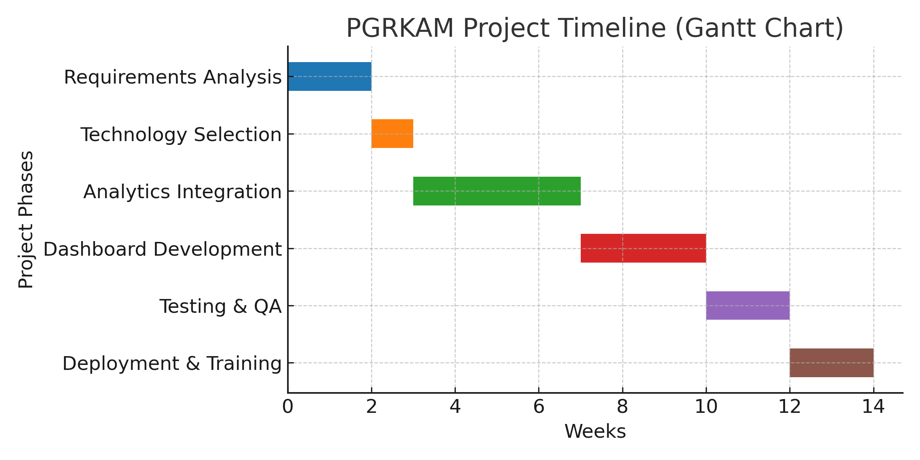
Timeline of the Project (Gantt Chart)

Slide 11
Expected Outcomes
Integrated Analytics Dashboard for PGRKAM.
Better User Insights (job preferences, search trends, engagement patterns).
Personalized Job Recommendations for candidates.
Improved Policy-Making with data-driven reports.
Enhanced User Engagement through a more responsive platform.
Scalable System that can expand with more features in future.

Slide 12
References (IEEE Paper format)
[1]. A. Kumar, B. R. Patel, and C. Zhang, “Plant disease identification using convolutional neural networks,” IEEE Access, vol. 9, pp. 34567–34578, Mar. 2021.
[2]. J. Smith, “Deep learning in agricultural systems,” IEEE Transactions on Neural Networks and Learning Systems, vol. 32, no. 7, pp. 1234–1245, Jul. 2021.

Slide 13


